Slide 1
UNIT-3
References
Carlo Ghezzi, Mehdi Jazayeri, ―Programming Language Concepts‖,3rd Ed, Wiley Publication ISBN : 978-81-265-1861-6.

Slide 2
Outline
Structuring of Program-
Software design method
Concepts in support of modularity
Encapsulation
Interface and implementation
Separate and independent compilation
Libraries of modules
Language features for programming in the large
Program organization
Grouping of units
Encapsulation, Interface and implementation
Abstract data types, classes, and modules,
Generic units,
Generic data structures
Generic algorithms
Generic modules
Higher levels of genericity
Programming paradigms-
Introduction to programming paradigms
procedural, object oriented, functional, and logic & rule based.
Study of Java as Object oriented programming language.

Slide 3
Lets start with “Structuring of Program”

Slide 4
Introduction
In unit-2 we have discussed structuring of data and computations which is useful for programming in small
Also we have seen the use of control structures for structuring large programs.
Here we strictly discuss issues of programming in the large using
Concepts for structuring large program
Encapsulation
Interfaces
Information hiding
And programming language support for same
Packaging
Separate compilation
Concept of genericity in building Software components libraries
Methods used for small programs not necessarily “scaled-up” for large

Slide 5
Introduction (cont..)
Two fundamental principles for programming in large
Abstraction
Allows us to understand and analyze the problem
modularity
Allows us to design and build program from smaller pieces called modules
In general if modules correspond closely to abstractions discovered during analysis, the program will be easier to understand and manage.
The principles of modularity and abstraction help us apply the well-known problem solving strategy known as “divide and conquer.”

Slide 6



Example: Airline reservation system
System has to perform correctly
The system is long-lived
Easy to maintain for updation in price, type, time of flights or add/ delete new flights
To achieve these goals systematic s/w design methods are required
Airline
Database
Add/update flight details
Inquire / reservation /
Cancel
Admin
User /
Reservation Agent

Slide 7
Software design method
Systematically guides us to compose large programs from smaller units called as modules.
Good design ensures well defined and controlled interaction between modules.
Then PL is used for implementing these designs.
Main goal of s/w design is appropriate decomposition of large problem into small modules.
This can be achieved by information hiding.
Information hiding (IH) distributes secrets wherever required and hided from others.
Hence if changes are made in module with IH, only modules who knows secrets need to be modified.
Adv. Of Highly independent modules
Work distribution among team member is easy and more independently they can work.
The more independent the modules are, the more easily the correctness of the individual modules may be established as the correctness of entire system depends on correctness of individual module
Defects in the system may be repaired easily.

Slide 8
Concepts in support of modularity
Modularity is very important and key concept in s/w design methods.
Pascal and C supports abstractions via procedures and functions
C++ supports same using classes
Various PL provides facilities to support modularity such as encapsulation, interfaces, separate & independent compilation, library of modules, etc.
Procedures &
Functions
Service provider /server
1.Effective way to break program into smaller units for structuring small programs and limited to single file.
Two modules:
Client/
User
Notes:
1. A good module represents a useful abstraction by providing interactions with other modules and granting accesses to only the required features or functionality.
2. Pascal & C
3. C++ supports same using classes by combining data structures & related operations

Slide 9
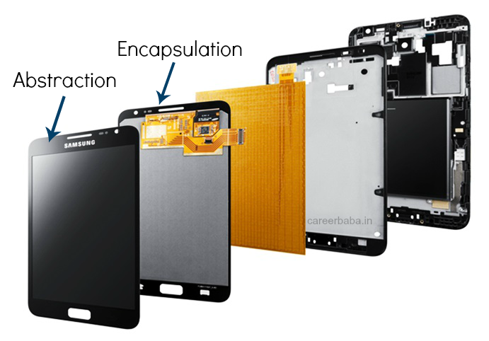
Encapsulation
Is a way to group together the program components that combine to provide a service and to make only relevant features visible to the clients.
Information hiding is a design method that focuses on concealing information during modularization.
Encapsulation is a linguistic construct that supports implementation of information hiding modules.

Slide 10
Encapsulation (cont..)
Modules with encapsulation are clearly described by 2 parts-
Specification- how the services provided by module are accessible to clients
Implementation- describes modules internal secrets that provides the specified services
Example : Implementation of Dictionary Data Structure
Clients can store <“name”,“id”> pairs & retrieve/delete elements by <“name”>
Encapsulation hides internal structure of dictionary from clients

Slide 11
Encapsulation (cont..)
Benefits of use of encapsulation in program
The client is simplified: clients do not need to know how the unit works in order to be able to use it; and
The service implementation is independent of clients and may be modified without affecting the clients.

Slide 12
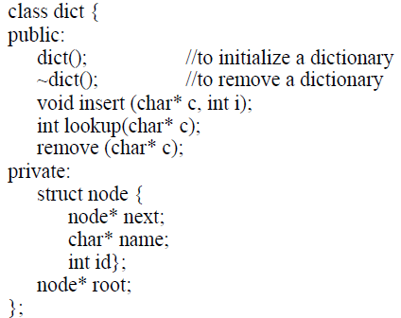
Encapsulation (cont..)
C program achieves encapsulation via files.
Example:
//mystring.h
int strleng(char s[])
{ int i; //visible in function
for(i=0;s[i]!=‘\0’;i++);
return i;
}
//try.c
#include“mystring.h”
void main()
{ int len;
len=strleng(“hello”); //code invisible
printf(“\n Str len is=%d”,len);
}
C++ support class for same.
Example:
linked
Provides
Access to
dictionary object
Invisible to
Users of this
class
Notes:
Typically, the entities declared at the head of a file are visible to the functions in that file and are also made available
to functions in other files if those functions choose to declare them. The declaration:
extern int max;
states that the variable max to be used here, is defined—and storage for it allocated elsewhere.
Variables declared in a C function are local and known only to that function. Variables declared outside of functions are assumed to
be available to other units, if they declare them using the extern specifier.
But a unit may decide to hide such variables from other units by declaring them as static.

Slide 13
Interface and implementation
A module encapsulates a set of entities and provides access to some of those entities.
The available entities are said to be exported by the module.
Each of the exported entities is available through an interface.
The collection of the interfaces of the exported entities form the module interface
A service provider exports a set of entities to its clients.
A client module imports these services
The simplest interface is provided via procedure or function i/f
Ex. int max(int &x, int &y) //provides signature

Slide 14
Interface and implementation (cont..)
C++ : unit of encapsulation is class & provides interface to class via member functions/data of the class which are available to client by making them public.
Ex.
Public entities Provides
Interface

Slide 15
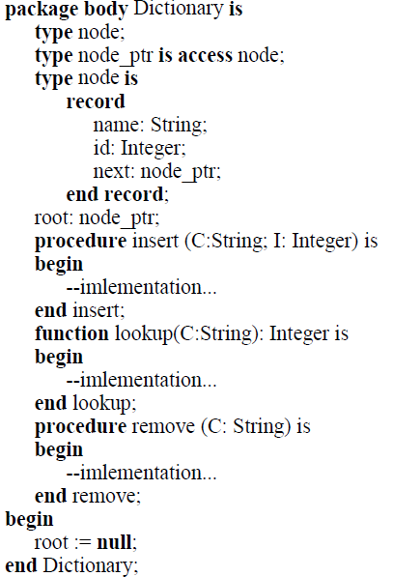
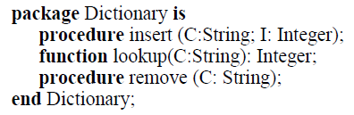
Interface and implementation (cont..)
Package Body with all implementn. details hidden from clients
In Ada programming strictly separates interface & its implementation. In Ada →
Unit of encapsulation is package
Package encapsulates procedures, functions, variables, and types
Package interface consists interfaces provided by all above entities (called as package specification).
Implementation of package is called package body.
Example:
Package Specification provides interface

Slide 16
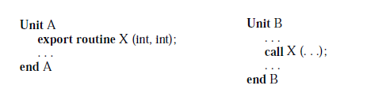
Separate and independent compilation
Separate Compilation | Independent Compilation
Modules compiled separately but follows specific ordering constraints. | Modules are compiled and tested independently. (no ordering constraint)
Ordering is required to check inter-module references | No static checking among modules
Ex. Ada supports separate compilations | Ex. C supports independent compilation
Example:

Slide 17
Libraries of Modules
Need of grouping related modules/units in libraries.
Example :
String operations
Mathematical operations
Matrix manipulation routines.
A library collects together a number of related and commonly used services.

Slide 18
Language features for programming in the large
Physical Modules→ Program decomposed into small units during implementation
Logical Modules→ identified at the time of design
represents abstractions at design level
Can be implemented into one or more phy. modules
More close relationship between the phy. and logical module, better the physical program organization reflects the logical design structure
We will descuss Pascal, C, C++, Ada and ML prog. lang. with following points
Module Encapsulation
Tells →Unit of modularity, which prog. paradigm supported
Separation of interface from implementation
Specifies→ relation among modules, which module imported & exported by modules
Program organization & module grouping
Tells→ how independently phy. Modules implemented & compiled
visibility & access control support of prog. lang.

Slide 19

Language features for programming in the large → Pascal
Module Encapsulation
Unit of modularity is Procedures & Functions
Supports Procedural Programming
Program Structures
Prog. Organized in tree like structure of modules
Example: top-down modular design of a module A identifies two modules B and C providing subsidiary procedural abstractions. Similarly, module B invokes two private procedural abstractions provided by modules D and E. Module C invokes a private procedural abstraction provided by F.
Declarations
Operations
Built-in or user written procedures or functions

Slide 20
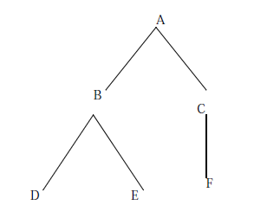
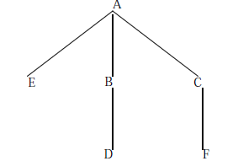
Language features for programming in the large → Pascal
Problem with struct.-1
Unable to show restrictions among procedure invocations.
Ex. ‘E’ may invoke D, B, & A
‘C’ may invoke B & A …so on
Also module ‘F’ needs abstraction by ‘E’ then this will fail hence needs rearrangements of modules as
Problem with struct.-1
No hierarchy maintained
‘E’ is visible to all procedures even though not required
Variables required to be shared between ‘B’ & ‘C’ need to be kept in ‘A’ which makes it visible to ‘E’
Prog. Struct.-1
Prog. Struct.-2

Slide 21
Language features for programming in the large → Pascal
Further problems
Textual layout
Entire program is a single monolithic text
Programs are difficult to read
Programs are difficult to test/debug
Programs are difficult to modify
Separation of interface from implementation
Pascal supports independent module development by using info. hiding at design level
Modules can be tested & compiled separately and kept in libraries for reusability

Slide 22
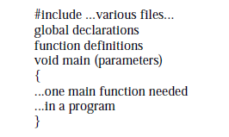
Language features for programming in the large → C
Supports Procedural Programming.
Program decomposed in Functions.
Physical unit of modularity is a file.
General Structure of ‘C’ prog.

Slide 23
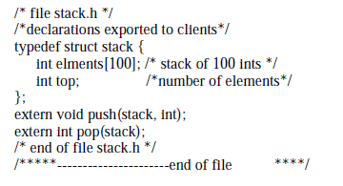
Language features for programming in the large → C
Logical module implemented by two phy. Modules→
Interface → header/include files (*.h files)

Slide 24
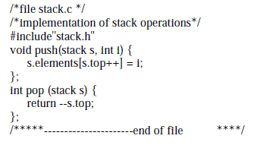
Implementation→ private part of module & services exported to clients

Slide 25
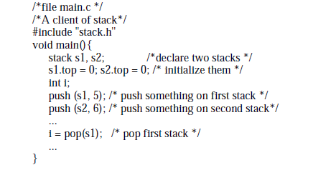
Client/user of service
The header files are used to resolve inter-module references at compile-time.
At link-time,
language provides no encapsulation facilities.
For example, the main program in Figure has complete access to the internal structure of the stacks s1 and s2.

Slide 26
Language features for programming in the large → C++
Physical unit of modularity is a file.
Program decomposed in Functions.
Supports Class-based Programming.
Class forms logical unit of modularity that supports the implementation of information hiding modules and abstract data types.
It can be combined with templates, classes may be used to implement generic abstract data types.
The class provides encapsulation and control over interfaces

Slide 27
Language features for programming in the large → C++
Encapsulation in C++
A class serves several purposes including:
A class defines a new (user-defined) data type.
A class defines an encapsulated unit.
Entities defined by a class can be of three types
public—exported to clients
private— hidden from clients
Protected —exported to entities derived from base calss
Object: is an instance of class. Used to access services offered by class.

Slide 28
Language features for programming in the large → C++
Program organization:
Program is composed of classes
Classes define the abstractions
The main program or a client creates instances of the classes called as objects
Objects are used to calls member functions of class to perform the desired task.

Slide 29
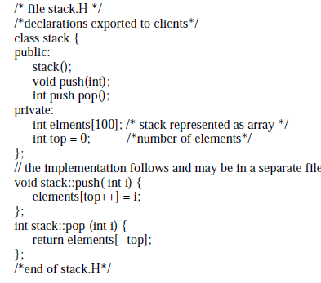
Language features for programming in the large → C++
Example: Class implementing a stack of integers

Slide 30
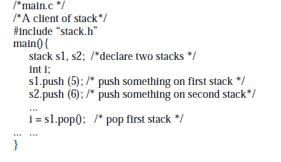
Language features for programming in the large → C++
Example: Class implementing a stack of integers (cont..)

Slide 31
Language features for programming in the large → C++
C++ supports the development of independent modules
A class’s interface and implementation may be separated and even compiled separately from each other.
The implementation must include the interface definition and therefore must be compiled after the interface file exists.
Client modules may be compiled with access to only the interface modules of the service providers and not their implementation modules.
Any names defined in a class are local to the class unless explicitly declared to be public.

Slide 32
Language features for programming in the large → C++
Grouping of units
C++ has several mechanisms for relating classes to each other
Nested classes- but suitable for programming in small
Friend functions-
special functions which can access the private members of a class.
Namespace-
Namespace is a container for identifiers. It puts the names of its members in a distinct space so that they don't conflict with the names in other namespaces or global namespace.

Slide 33
Language features for programming in the large → C++
Friend functions-
A class in C++ defines a user-defined type.
As a result, the operations it defines as public are operations on objects of that type.
For Example-
Consider a class of complex no., it may have a data part that stores the real and imaginary parts of the number, along with exported operations that let clients create and manipulate objects of type complex.
But consider addition operation on two complex objects.
Which of the two complex objects is the operation a member of?
Another example-
Multiply a vector with a matrix→ multiplication is a member of vector class or matrix class?
To allow these related entities in C++ “Friend functions” are used.
Ada and Modula-2 allow these related entities to be packaged together in a single module
Notes:
1. the following declaration creates two complex numbers:
complex x(1.0, 2.0), y(2.5, 3.5);
2. The other declarations state that the operator functions to be defined later (+, - , *, and /) are friends of the class complex and thus may access the private parts of the class.
class complex {
public:
complex(double r, double i ){re = r; im = i;}
friend complex operator+ (complex, complex);
friend complex operator- (complex, complex);
friend complex operator* (complex, complex);
friend complex operator/ (complex, complex);
private:
double re, im;
};
Defining these operators as friend functions allows the clients to naturally use
these functions as binary operations such as:
complex c = x + y;
3.

Slide 34
Language features for programming in the large → C++
Namespace-
In C and in C++, the unit of global naming is a file.
Any names defined at the outer level of a file are known globally by default.
For example, the names of all classes defined in a library are known to any client that includes that file.
What if two libraries provide two classes with the same name?
How can a client use both of those classes?
How can a library provider add a new service to its library and be sure that the new name of the service does not conflict with any existing uses of the clients?
a single global name space is a serious problem in the development of large programs

Slide 35
Language features for programming in the large → C++ (cont..)
Namespace-
The solution of C++ is to partition the global name space into a smaller groups; each group is called a namespace
Namespace can be used in different ways
One is to directly name the definition with :: operator
Import all definition from namespace
For Example using :: operator
#include <iostream>
using namespace std;
// name space1
namespace my_space1{
void func(){
cout << "Inside my_space1" << endl; }
}
// name space2
namespace my_space2{
void func(){
cout << "Inside my_space2" << endl; }
}
int main () {
// Calls function from my_space1.
my_space1::func();
// Calls function from my_space2.
my_space2::func();
return 0;
}

Slide 36
Language features for programming in the large → C++ (cont..)
For Example using namespace
#include <iostream>
using namespace std;
// name space1
namespace my_space1{
void func(){
cout << "Inside my_space1" << endl; }
}
// name space2
namespace my_space2{
void func(){
cout << "Inside my_space2" << endl; }
}
using namespace my_space1;
int main () {
// Calls function from my_space1.
func();
return 0;
}

Slide 37
Language features for programming in the large → Ada
Supports programming in the large
Ada makes an explicit distinction between specification and implementation of a module.
A file may be compiled if the specifications of the modules it uses are available.
Thus, Ada naturally supports a software development process in which module specifications are developed first and implementation of those modules may proceed independently.
Ada also requires the existence of a compile-time library in which module specifications are compiled.
A module may be compiled if all the module specifications it needs are already in the library.
This library supports the checking of inter-module references at compile time

Slide 38
Language features for programming in the large → Ada
Encapsulation in Ada
Unit of modularity is “Package”
An Ada module encapsulates a group of entities and thus supports module-based programming
It separates specification and implementation to hide implementation details
Ada supports the separate compilation of procedures and functions as well as packages

Slide 39
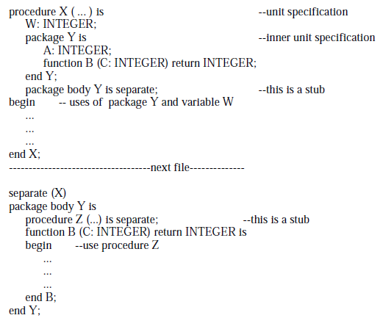
Language features for programming in the large → Ada
Program Organization
Notes:
1.An Ada program is a linear collection of modules that can be either subprograms
or packages. These modules are called units
2. Module declarations may be nested.
3. Consequently, a unit can be organized as a tree structure of modules.
4. Package body and implementation separated if they are nested just to avoid problems of

Slide 40


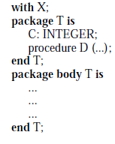

Language features for programming in the large → Ada
Program Organization
Use of keywords
Separate
With
is –end pair

Slide 41
Language features for programming in the large → Ada
Interface and implementation
Separate package interface and specification supported
Helps to support separate compilation of units with certain ordering constraints
Grouping of units
It support programming in large
Use and with clauses are used to import services from other packages
With clause: used by client to import services from provider module.
Package entities are accessed using
package_name.entity_name
Use clause: used to avoid use of “.” operator to access entities
with dictionary;
package phone_list is
...
--references to dictionary.insert(), etc.
...
end phone_list;
with dictionary; use dictionary;
package phone_list is
...
--references to insert(), etc.
...
end phone_list;

Slide 42
Language features for programming in the large → Ada
Child Libraries:
Ada package groups together a set of related entities
That can be used by client using “with & use” clause
To support reuse of existing modulesm, it support grouping a collection of library modules.
Problems in grouping.
Two Packages may have entity with same name (duplicate names)
To resolve it renaming facility is provided by Ada
Initially no duplicates in packages but on updates → chances of name clashes arises
Which may generates error
After releasing updated version recompilation is required for both updated module & client code

Slide 43
Language features for programming in the large → ML
Functional programming language
Supports modularity & modules are separately compliable units
Encapsulation in ML
Modular unit contains
Structures- Structures are the main building blocks
Signatures- signatures are used to define interfaces for structures
Functors- functors are used to build a new structure out of an existing structure
(ref. link : https://www.it.uu.se/edu/course/homepage/kompprojekt/vt13/slides/structures.html )

Slide 44
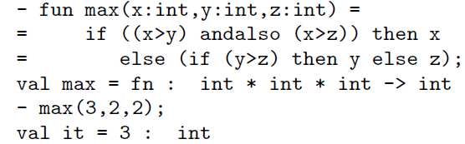
Structure
Functions
structure IntLT = struct type t = int val lt = (op <) val eq = (op =) end

Slide 45
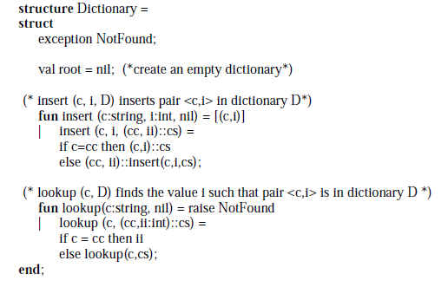
Language features for programming in the large → ML
Program Organization in ML
The ML structure is somewhat like the Ada package, used to group together a set of entities.

Slide 46

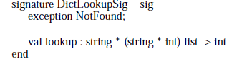
To use the structure, a client uses the dot notation:
Interface and Implementation
The signature of a structure definition consists of the signatures and types of all the entities defined in the structure
It helps to provide interface to client/user

Slide 47
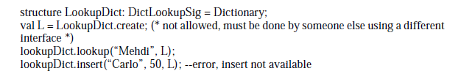
We can use the structure and signature we have to create a new module with a restricted interface and use it accordingly:

Slide 48
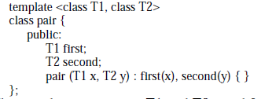
Generic Units
Generic Data Structures
Implemented using Templates
Example
The template parameters T1 and T2 stand for any type.
We may “instantiate” a particular pair by supplying concrete types for T1 and T2.
For example, we may create a pair of integers or a string, integer pair or a pair of employees:

Slide 49
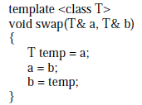
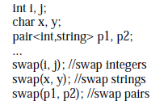
Generic Units
Generic Algorithms
Creating generic functionality that implements specific algorithm to manipulate generic data.
Function templates can be used
Example in c++

Slide 50
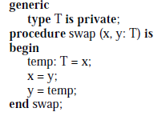
Generic Units
Generic Algorithms
Example in Ada
Generic Modules
Collection of data & algorithm packaged together
C++ & Ada supports this facility

Slide 51
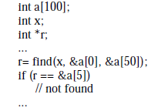
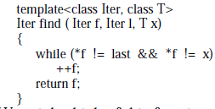
Generic Units
Higher levels of genericity
Generic algorithms should work on all type of objects
(different type of data types & data structures)
Higher level of genericity can be achieved by writing the algorithms & creating library of which will work on any data type & data structures (linear or non-linear)
This facility is supports by function lang. like ML & object oriented lang. C++ (not supported in C)
Example: operations (*, ++, = =,!=) on pointer integrator
Implementation of Service
Use of Service

Slide 52
Advantages of higher level of genericity
Various algorithms with any data type & data structure can be implemented and provided in Standard Library
Algorithm writing efforts reduces (for large programs)
Easy to customize existing algorithm for specific use is
Reusability increased

Slide 53
Programming Language paradigms
A programming paradigm is a style or “way” of programming.
It defines methods of problem solving & approach to design programming language
Main 4-Type of Programming language paradigms
Procedural or Imperative Programming
Object Oriented Programming
Functional Programming
Logical / Rule Based Programming

Slide 54
1. Procedural or Imperative Programming
It relies on procedures & functions or routines or subroutines
It is also called top-down languages
Derived from latin word imperare means “to command”
In imperative programming, you tell the computer what to do step by step (how).
"Computer, add x and y," or
"Computer, slap a dialog box onto the screen."
And (usually) the computer goes and does it.
Is a programming paradigm that describes computation in terms of statements that change a program state.
It is also called as statement based or statefull programming
Advantages
Easy to implement & low memory utilization
Disadvantages
Difficult to handle complex problems
Parallel programming not possible
Less productive
Example: C, Pascal, Fortran & Cobol, etc.

Slide 55
2. Object Oriented Paradigm
It is a paradigm where we focus real life objects while programming any solution.
All computations are carried out using objects
Object-oriented programming (OOP) is a programming paradigm that uses "objects" – data structures consisting of data fields and methods together with their interactions – to design applications and computer programs.
Advantages:
Supports modularity, Easy to maintain and update
More protected as supports abstractions and information hiding
Testing and debugging is easy
Disadvantages:
Programs are larger in size compare to other programs
Slower programs : Object - oriented programs are typically slower than procedure - based program s, as they typically require more instructions to be executed.

Slide 56
Fundamental Concepts / Features of OOP
Class
Object
Method
Message passing
Inheritance
Polymorphism
.
.
Example:
C++ ,Java , Ada , Effel, Smalltalk, Python, etc.

Slide 57
3. Functional Programming
It treats computation as the evaluation of mathematical functions and avoids state and mutable data.
It emphasizes on composition and arrangement of functions, often without specifying explicit steps.
Advantages
Functions are reusable
Due to use of functions programs are more readable and easy to understand
Disadvantages
Consumes large amount of time and memory for execution
Less efficient

Slide 58
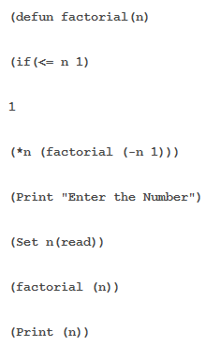
Cont..
Example of Functional Languages
LISP, Scheme, ML, Haskell, etc.
Example in LISP

Slide 59
4. Logic Programming Paradigm
It is the use of mathematical logic for computer programming
It is a sequence of logical statements that is given an operational semantics, i.e., it can be executed on a computer.
It is based upon the fact and rules
Eg. :
If B₁ and … and B_{n} then H
Advantages
More reliable and supports quick development of program using true and false statements,
It is suitable to solve knowledge base problems
Disadvantages
Executions is slow
True-false statements can solve only limited problems efficiently.

Slide 60
4. Logic Programming Paradigm _Example: Prolog
Prolog is a general purpose logic programming language associated with artificial intelligence and computational linguistics
It is based on Facts and Rules
Eg. :
if X==Y then (s) else fail end

Slide 61
Programming paradigms
 | Procedural | Object Oriented | Functional | Logic & Rule Based
Unit of Modularity | Procedures or Functions | Classes or packages | Functions | Predicates
Adv.
Dis. Advantages
Languages Support | Pascal & C | C++ ,Java , Ada Effel, Smalltalk | ML, LISP APL | PROLOG

Slide 62
Functional Vs. Logic programming
the major difference is the "building blocks":
functional programming uses functions
while logic programming uses predicates.
A predicate is not a function; it does not have a return value.
Depending on the value of it's arguments it may be true or false;
if some values are undefined (usually) we will try to find the values that would make the predicate true.

